Slide 1
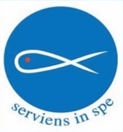
New Member Experience Model - Discussion Contents
New Member Experience Model Overview
  Phase 1: Recruit
  Phase 2: Discern
  Phase 3: Engage
Getting Started
  Links to Resources
  Contacts

Slide 2
New Member Experience Model
Recruit
Onboard
Engage
Calling Vincentian Vocations
Building Vincentian Vocations
Engagement through Serving in the Ministry
Initial Reach Out
Orientation
Screening
Training
Supporting with Mentor Model
Guided by the Holy Spirit

Slide 3
Recruit: Calling Vincentian Vocations
Always Be Recruiting
Considerations
Face to face conversations
Monthly collection
Addresses to the congregation
SSVP events: back to school, Christmas events
Presentations to other ministries: CLW, Knights, Bible study, RCIA, etc.
Include key information in the needs right in our own community (e.g., number of families, children, etc.) Reference Impact statements for this type of readily available information
Try to arrange the initial reach out call quickly (within36 hours) as experience shows that it is important to connect with them early

Slide 4


Onboard: Initial Reach Out
Method
Suggested Topics / Scripts
Initial Phone Call (ideally within 36 hours) | Conduct a 15 minute call with them to learn about the candidate Share an overview of the Ministry (who we serve, home visits, highlight activities from Annual Impact Statement, etc). Understand their skills – what they could bring to the Ministry Explain minimum commitment (and that if they can’t meet it maybe it isn’t the right time for them)
Initial Email (ideally within 24 hours of initial Phone Call) | Hello. It was a pleasure speaking with you and thank you for your interest in joining the Ministry. To follow is our new member welcome email. We are a very active and vibrant Ministry and I am sure that you will greatly enjoy being involved and meeting and interacting with the families we serve and the fellow SSVP members. I am forwarding you an introductory letter for new members, which outlines how we serve in our Ministry and this will provide you with a good overview. We hold our monthly food box distribution on the 1st Tuesday of every month. We also hold a monthly meeting on the 2nd Wednesday of the month. We ask that members commit to doing their best to assist with the 12 food box distributions and attend the meetings per year as a minimum commitment and do their best to assist with the various events that run through the year. In time we will welcome you to the home visitation team. We organize a Back to School event and a Christmas drive. You will find the new member envelope in the mail room (it is the small room just off the Narthex past the bulletin board). The SSVP mail cubby is the top right slot. There are volunteer screening requirements for both the parish and SSVP so the package is quite detailed but if you have any questions at all, please do not hesitate to call or email me. The next step will be to attend an orientation and screening meeting at a time that will best suit your schedule. Once you have the new member forms completed, please let me know so that we can take the next step with the orientation and screening meeting. After the orientation session, there are some training requirements to complete, including watching 3 videos and attending a training session with other members from conferences in Halton (Oakville, Burlington and Milton) Thank you again for your interest in the Ministry and we will look forward to welcoming you into service!

Slide 5

Onboard: Orientation
Method
Suggested Topics / Scripts
In Person Meeting | Introductions Start with SSVP prayer Mission and Values , History, Logo Rule book SSVP Structure Structure of the Team Family Base Step 1 / Step 2 process – how we welcome in new families Home Visits - the Core of the Ministry New members partnered with experienced volunteers Always visit in pairs never alone Pray before each visit so we will be guided We are welcomed in as guests in their homes. We listen and refer Family Database is maintained - family name, date of registration, number of children, address Role of Informed Navigator- walking alongside the neighbours to access to programs, opportunities and services | Share key resources in new family welcome package – HPC resource recap, Food resource page, Where to get Food in Halton, Where to get Help in Halton, Safetynet, Halton Community Legal Clinic Food box event - Every 1st Tuesday of the Month Monthly Meetings – Every 2nd Wednesday of the Month Share Events Calendar - Monthly meetings, collection, Christmas drive, Back to school drive Systemic Change Projects - RESP/Canada Learning Bond program , Recreational project, Dental project, Ontario Electricity Program, RDSP project Email to follow on next steps in the Orientation and Training process Encourage all members to subscribe to Ontario SSVP website www.ssvp.on.ca National SSVP website www.ssvp.ca SSVP US Home - SVDP USA (ssvpusa.org) FAMVIN (international website) www.famvin.org

Slide 6
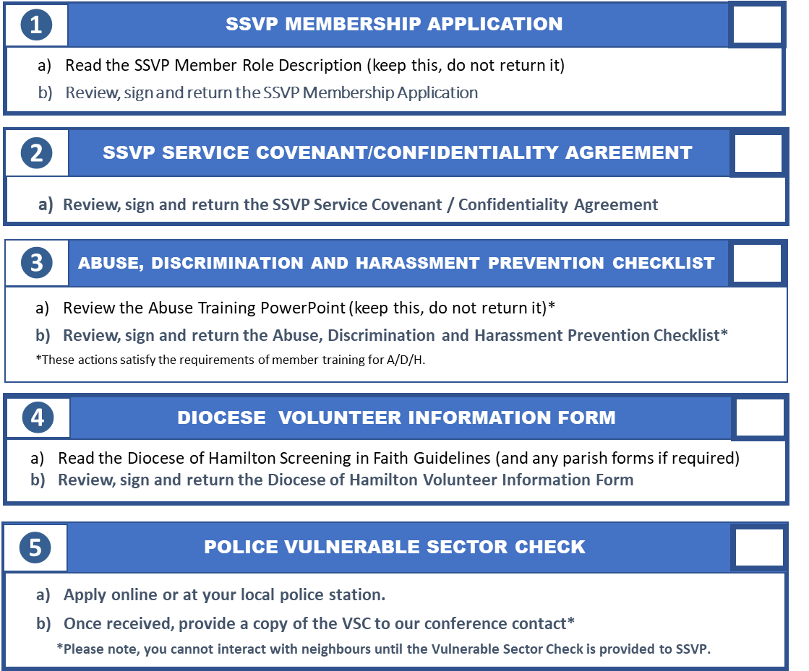

Onboard: Screening
Method
Checklist of Required Screening Forms
Completing online screening forms as required by SSVP Policies and our Insurance Requirements

Slide 7

Onboard: Training
Method
Suggested Training Modules/Topics
Virtual Training | Review The Vincentian Journey Foundational Training Guide (keep this, do not return it) Watch the Serving in Hope Training videos https://ssvphaltonpc.org Member Tab There are 3 - 45 minutes videos - Living our Values, Reaching out to our neighbours (Part 1) and Reaching out to our neighbours (Part 2). The training guide, The Vincentian Journey, was included in the new member welcome package. There is a Members Site that you can access from the home page. ID: ssvphaltonpc Password: haltonpcmember c) Training resources on the SSVP National Website Please briefly review the first 3 power point slides. An Introduction to our Society, The Conference, Home Visiting. You have already gone through the 4th module as part of your new member package. d) The SSVP National website is http://www.ssvp.ca and the direct link is https://ssvp.ca/members/formationresources/ e) Please sign up to subscribe to the monthly SSVP National Council newsletter in order to keep informed with the latest news, projects and activities across Canada. You will see the sign up icon to the bottom right of the National website at https://www.ssvp.ca/ f) The SSVP Ontario Region website is also rich with content. The website is http://www.ssvp.on.ca They produce a quarterly newsletter and you will see the subscribe icon at the bottom of the Ontario website.

Slide 8
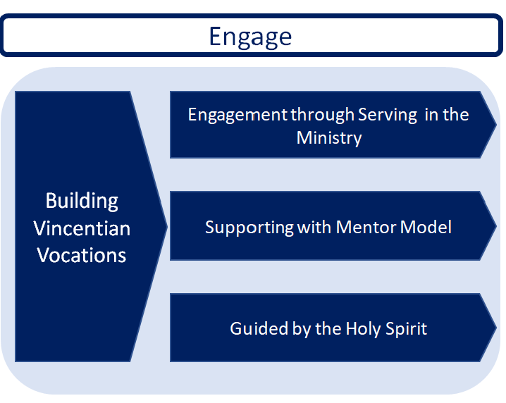
Engage
Home visits – our Charism
Monthly food box
Monthly meetings
Wellness calls
Fareshare pick up
Summer Barbeques
Monthly collection
Assign each new member with a seasoned mentor. Mentor Responsibilities and Expectations
Know and live the Mission and Values of the Society.
Be aware of our Social Justice projects, (CLB/Dental etc) and the goals of stretching past the food voucher to become informed navigators accompanying the families to access programs, opportunities and services
The role is to coach and mentor the new member and empower them to be able to walk alongside the family (understanding that we are not experts.)
Be willing to ask your mentee to take on more responsibility/tasks as needed by sharing requests or appeals for help.
Communicate via email or text on a regular basis, perhaps monthly, depending on the needs of the mentee and the schedules of both of you. Contact them after the monthly meeting and food box so they can talk about their experiences and can ask questions.

Slide 9
APPENDIX

